Slide 1
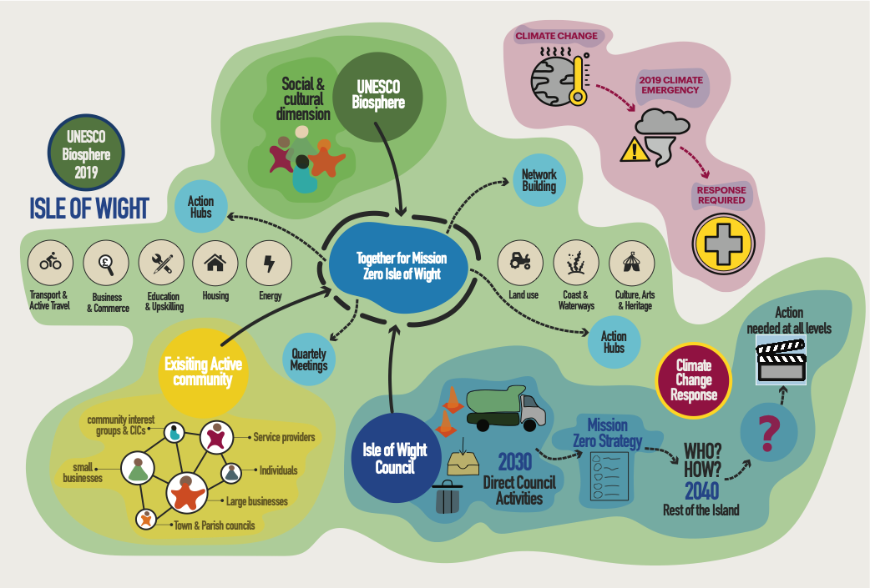
Mission Zero for Business
Presentation to the Economic Development Board
26 Jan 2023

Slide 2
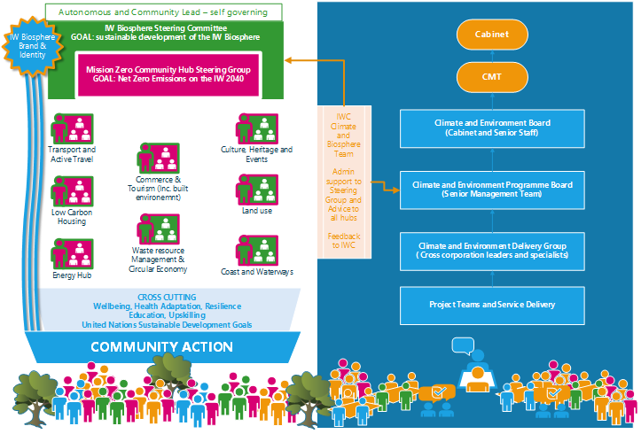
Mission Zero and Biosphere governance structure

Slide 3
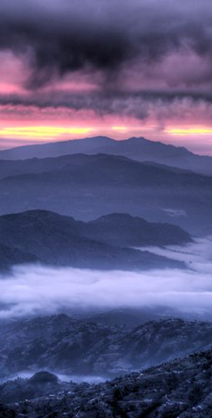
Status
Underway
Biosphere Steering Committee formed
To Be started
Land, Energy, Housing, Active Travel Hubs up and running
Tourism, Coastal/Waterways, Arts/Culture/Heritage, all initiated.
Events and Waste & Resource Management forming
Mission Zero Community Hubs and steering committee formed
Business and Commerce is yet to form.
Together for Mission Zero Community group running quarterly events
Notes:
Internally, a costed plan has been drafted, which is with Ann at the minute
Following that this will need council approval
First steps internally should focus on behaviour change, which will make up a lot of the low-cost activity behind the plan, particularly in the first couple of years
Buildings and fleet make up the largest part of the council footprint and will require the largest budgets to tackle – we will continue to seek grant funding for buildings and would like to see the council commit to an all-EV fleet at the earliest opportunity (although some vehicles aren’t available as EVs yet)
Island-wide, one of the key aspects, particularly early on, will be engagement. We’ve got a reasonably popular forum running already but it only has about 15 non-council regular attendees so we need to work more on connecting with people across the island
We will also be looking to any quick wins in the first couple of years – these are items that will help with engagement by showing that not everything behind the plan is going to be hard to achieve
Promotion of government grants will be important, particularly for decarbonising homes, as this is as expensive process without support and likely to be difficult to gain support for otherwise. Jim’s team have already done quite a lot of work relating to GHG

Slide 4
Targets for MZCH – Business and Commerce
Net Zero is a target for all businesses, however small.
The ask is to plot a journey for all businesses to:
Support Mission Zero and the Biosphere Reserve designation, including it in organisational mission statements/vision statements wherever relevant
Join and actively participate in the Green Impact Programme
Calculate and understand their carbon footprint and commit to working to meet net zero by no later than 2040.
Publicise the good work that many businesses are doing.

Slide 5
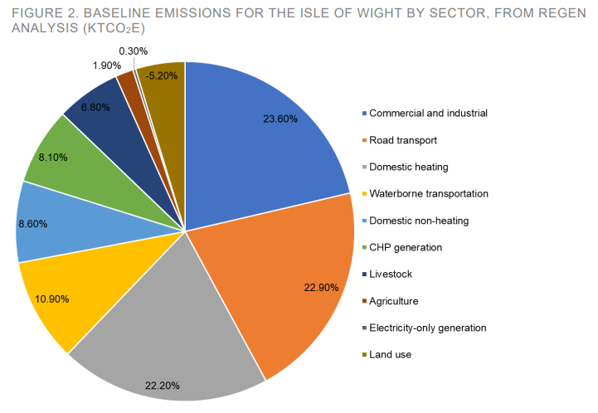
Isle of Wight emissions (2019) 558,200 tCO2e

Slide 6
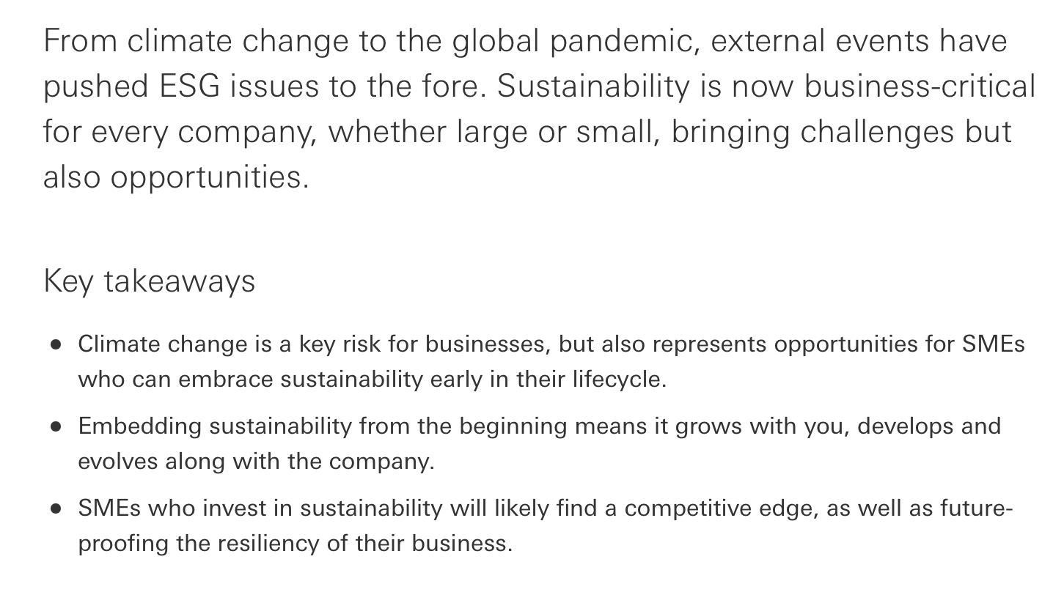
Why should businesses act now?

Slide 7
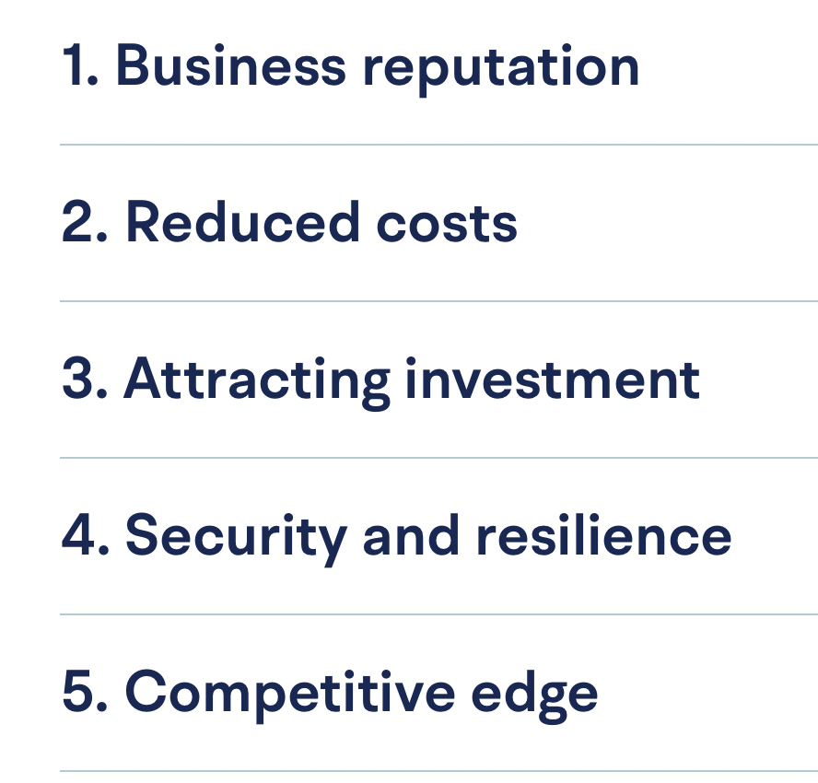
Benefits

Slide 8
Green Impact Programme
Green Impact – link
Green Impact is a United Nations award-winning programme designed to support environmentally and socially sustainable practice in SMEs
Bronze / Silver / Gold award annually
Online toolkit – easy to use with clear guidance
The chamber has been supporting it since 2018 but today we have under 30 active member companies from a high of about 60.

Slide 9
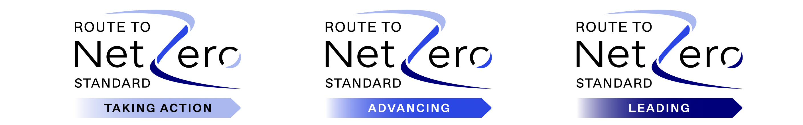
Carbon footprinting
Various online tools available
We expect to including carbon footprinting and net zero activity in next year’s Green Impact Toolkit launching in February.
Certifications and other programmes are also available, e.g. Carbon Trust certification with 3 tiers

Slide 10
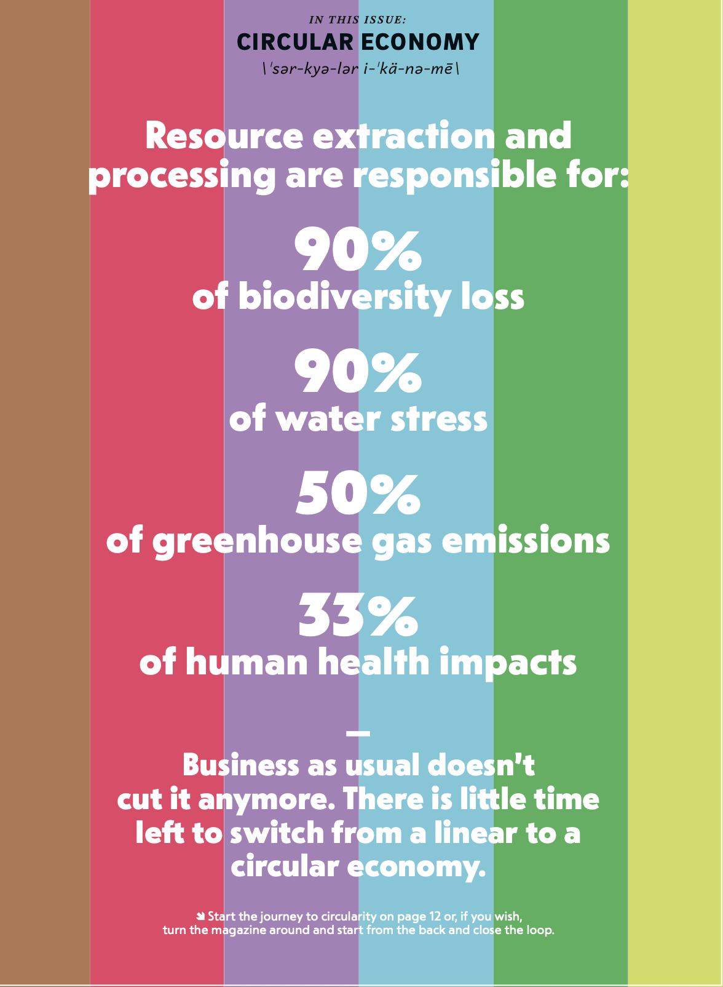
Need to focus on more than carbon

Slide 11

The United Nations Sustainable Development Goals
Looking at work through the lens of the Biosphere can be aided by consciously assessing all actions against the 17 goals.
By considering scope modifications we can often make the connection stronger, more visible ,or connect to more of them.

Slide 12
What will supporting the Biosphere look like for businesses?
The Biosphere Reserve Designation is about the balance between humans and the natural world.
Considering the SDGs in their decision-making.
Several other concepts refer or link to the SDGs, including:
A ‘fair green transition’
Doughnut economics (Kate Raworth)
Environment, Social, and Governance standards
If we live or work on the Island we are part of the Biosphere whatever we do.

Slide 14
Targets for MZCH – Business and Commerce
Net Zero is a target for all businesses, however small.
The ask is to plot a journey for all businesses to:
Support Mission Zero and the Biosphere Reserve designation, including it in organisational mission statements/vision statements wherever relevant
Join and actively participate in the Green Impact Programme
Calculate and understand their carbon footprint and commit to working to meet net zero by no later than 2040
Take the lead in forming a Business Hub with our support.

Slide 15
Back up info only

Slide 16
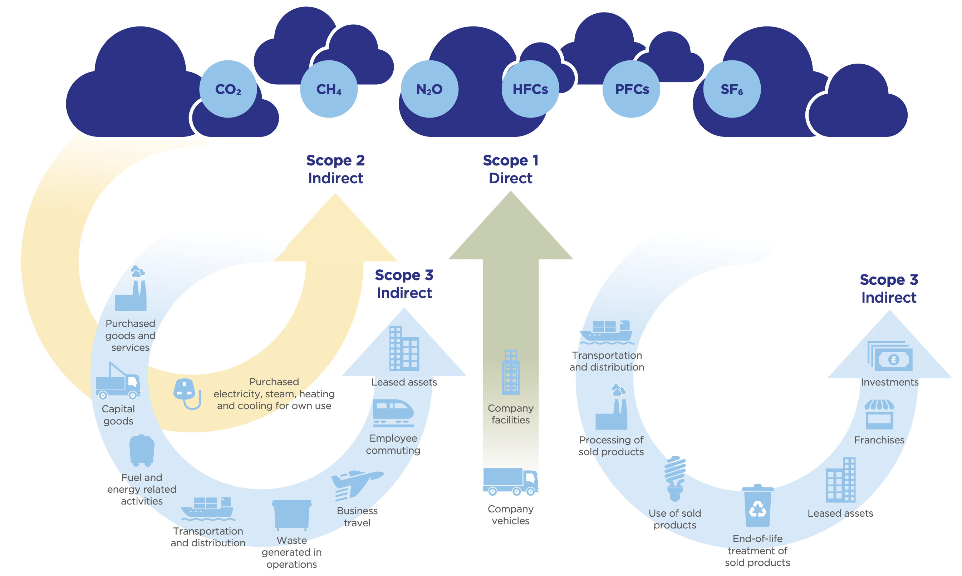
Scope 1,2 and 3

