Slide 1
Land Use Hub

Slide 2
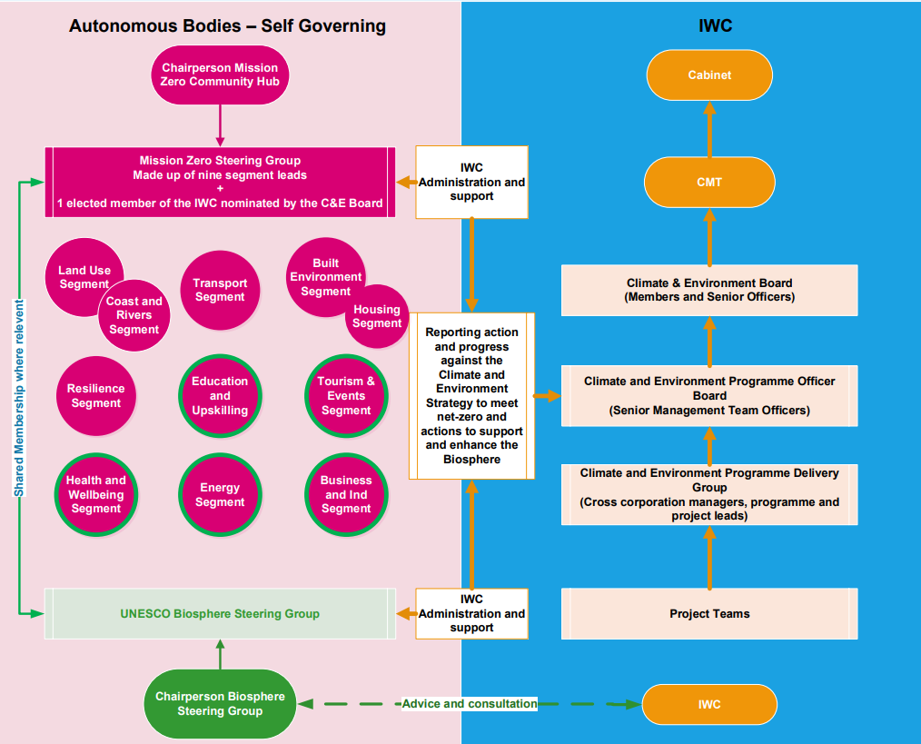

Slide 3
Leveraging the Biosphere, Mission Zero 2040 and the Land Use Framework to gain financial support for the Island transition towards a balanced use of land.
Biosphere
Mission Zero 2040
Land Use Framework
Unique and diverse ecosystems, celebrating the local endeavours to live harmoniously within them.
Net zero by 2040, with no more than 15% offset.
Improving the relationship between people and their local environment.
Sustainable social and economic development.
Equal consideration for Wellbeing, Ecology and Climate.
A partnership between the council and Islanders.
Delivered through 10 independent Action Hubs.
Agriculture is 30% of our footprint.
strategic approach to resolving competing claims that arise over this precious and finite resource
Land that is productive and ecologically resilient, supporting flourishing ecosystems and tackling climate change.
Provide a forum to maximise the islands ability to attract transition funding and provide a framework for the Land Hub.
A Land Hub would ideally be
Land could provide 20% of our net mitigation.
Landscape recovery Scheme could be the first of many such tasks as ELMS evolves.

Slide 4
The Land Use Framework/Land Hub. Draft for discussion.
Vision
Solve the four interlinked crises of:
Biodiversity loss
Mission
Work together locally while understanding the national and global context
Maximise the opportunities the transition brings.
Climate change
Food quality and insecurity, and
Rural community wellbeing and economic prosperity
Find common purpose solving the conflicts around changes in land use as we reduce carbon emissions
Be a UK leader in delivering profitable agroecological agriculture.
3 projects
Landscape Recovery Exploration.
Natural Capital Investment Vehicle
Land Use Framework

Slide 5
Transport Outcomes (from Mission Zero Strategy)
Land Hub Membership
Isle of Wight Council- AONB.
CLA
HIWWT
Natural England
RSPB
Southern Water
Chair
NFU
Environment Agency

Slide 6
Landscape Recovery Exploration – DEFRA funding application
Outcomes- biodiversity, water quality and net zero.
Co-funds substantial changes to land use and habitats.
  recovering and restoring threatened native species
  restoring the Eastern Yar water course.
The criteria will cover:
  longevity
  environmental benefits: species recovery / river restoration
  carbon and climate resilience
  social impact: public access, community engagement.

Slide 7
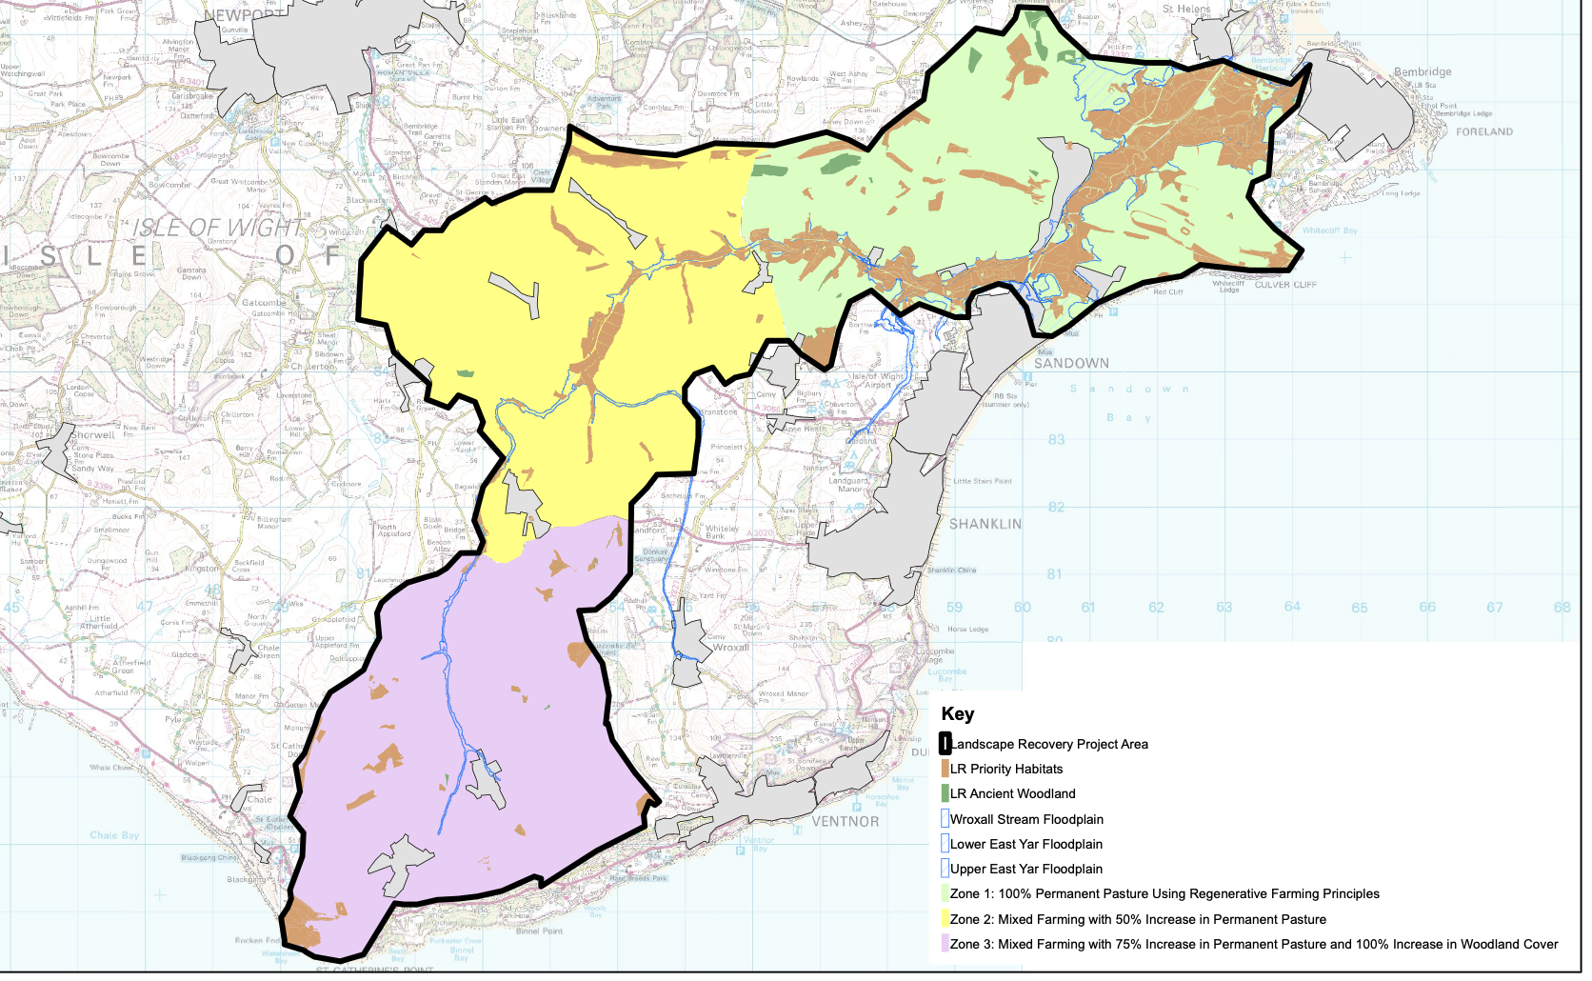

Slide 8
