Slide 1
IWC supporting the UNESCO Biosphere & Mission Zero

Slide 2
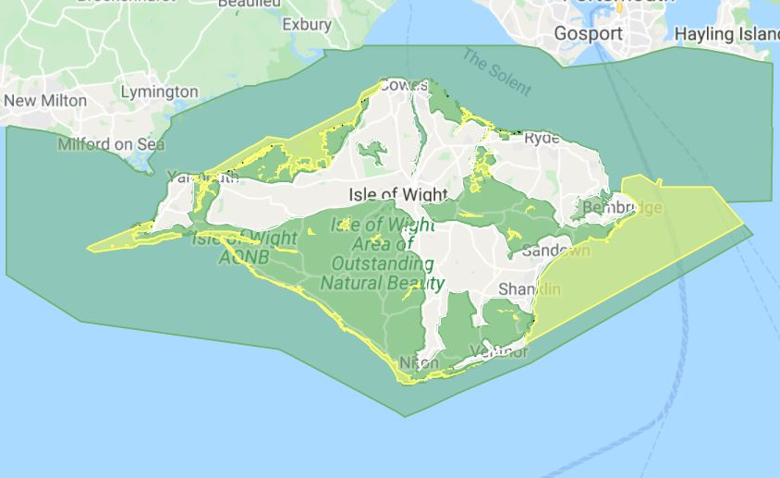
The Isle of Wight UNESCO Biosphere Reserve
2019 - Isle of Wight declared an international Biosphere Reserve.
Biosphere Reserves are about improving the relationship between people, culture and their local environment, globally.

Slide 3
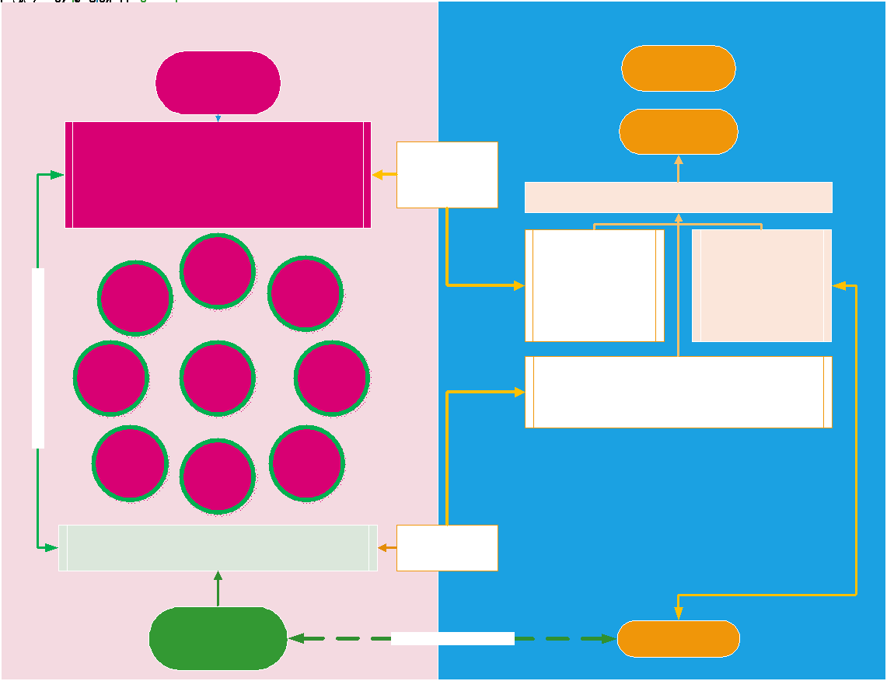

Slide 4
What are the challenges
challenge
Desired outcome
Challenging existing short term economic thinking
Presence and communication funding to engage ALL
Education and upskilling
Changing culture and behaviors towards net zero living.
Whole life/whole system accounting using doughnut economic models.
One island Web
Integrate new zero into all education levels.
All of as becoming activists.

Slide 5
Mission Zero
Climate and Environment Strategy 2021-240

Slide 6
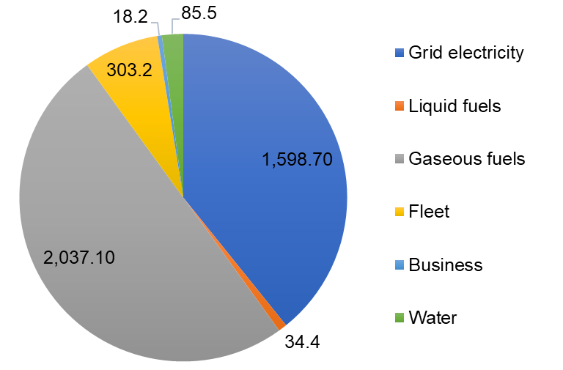
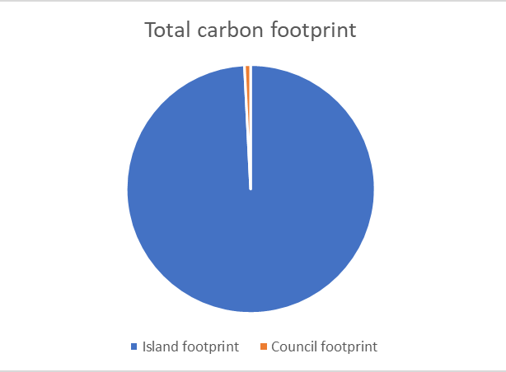
Isle of Wight carbon footprints
IWC: 4,184 tCO2e (2018-19)
Island: 506,900 tCO2e (2017)
Target: net zero with 15% offset

Slide 7
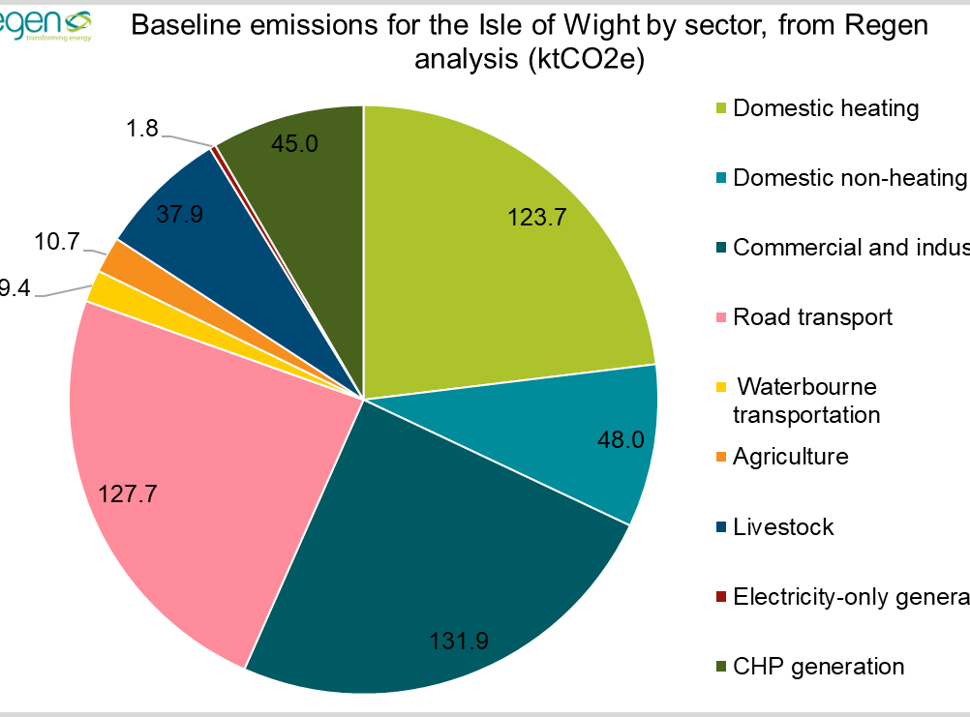
Isle of Wight carbon footprints

Slide 8
Offsetting proposed
Aim to offset a maximum of 15% of all emissions
May need to consider carbon credits as a last resort option
Emissions reductions should be the primary focus
Wider benefits of planting - not only for offsetting
Large scale planting schemes will be needed to meet 15% offsetting target locally
Notes:
Current aim stated is to offset 15% of emissions to meet net zero
However, emissions reductions should always be the primary area of concern – can’t plant our way out of a climate crisis
In order to meet this locally huge areas of land would be needed – this would really vary according to the type of planting with estimates ranging from 760 hectares up to 25,000+ hectares (possibly more) depending on type of planting, management, etc.
As there are so many wider benefits to any planting schemes I would suggest looking at those primarily and considering the offsets a bonus as it is quite easy to get caught up in the idea of offsetting your carbon footprint - can consider bath with a broken tap analogy as an outline
Because the area of land needed would be so large it may not be possible to offset a full 15% locally so carbon credits could be considered, however, owing to how some of these schemes work this should be an absolute last resort

Slide 9

The island community are resilient to a changing climate
Embed
Enable and support
Adapt
Low carbon thinking is part of the behavioral norm
Well insulated homes support wellbeing and affordability
Well insulated businesses are economically beneficial
10 per cent net bio-diversity gain in new developments supports the whole island
Residents to ensure homes are well insulated and fuel poverty is reduced
Residential and care homes to be adapted for colder winters and hotter summers
Schools to be adapted for colder winters and hotter summers with insulation and low carbon heating systems
Agriculture has adapted for changing rainfall patterns
Strategic transport networks are protected from flooding and erosion
Sea level rise is managed in accordance with SMP2/3 and residents in at risk areas are supported
Strategic infrastructure on potential flood plains have adaptation plans
Business and offices are adapted to keep staff and customers in a safe climate (heating and cooling strategies in place)
This Photo by Unknown Author is licensed under CC BY-NC-ND

Slide 10
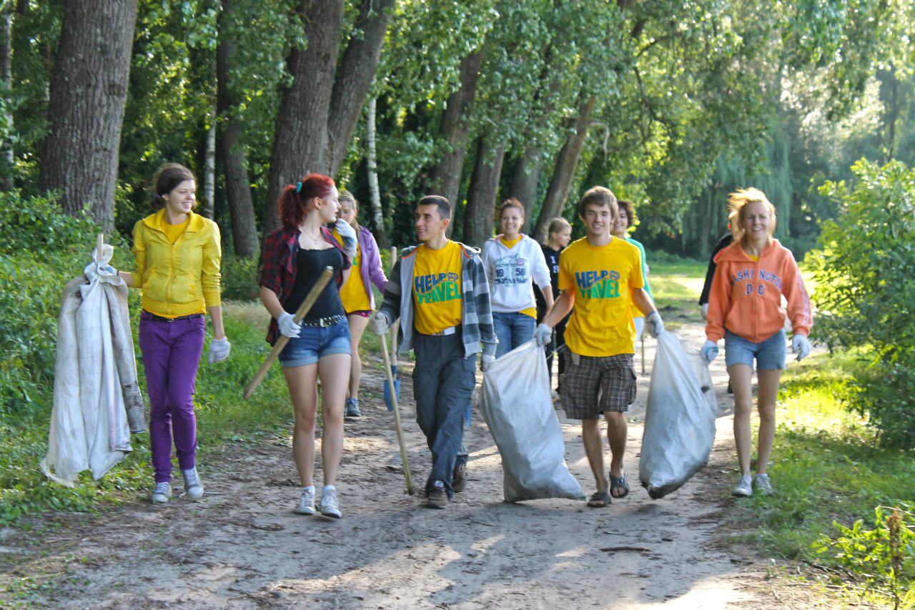
The Island’s community is enabled to achieve net zero carbon in 2040
Enable
Lead
Provide and enable
Enable communities –
Grant and funding information and advice on applying for grants is provided online and in the ESF
The ESF enables developing networks and community action plans
The ESF enables community champions to share knowledge and information
Lead promotion of and engagement in opportunities for business residents to source grants and free insulation
Provide and enable learning opportunities to ensure landowners are engaged with biodiversity net gain and emerging farming techniques for adaptation to a changing climate
This Photo by Unknown Author is licensed under CC BY-NC-ND

Slide 11

Next steps
Underway
Land and Energy Hubs up and running
Built environment and Transport hubs being initiated.
Various Council Building being fitted with PV and better insulation.
Net Zero imbedded within the Strategy and Action Plan
Env and sust forum running but needs more support.
To Be started
Education, wellbeing, Resilience, Ind and Com Hubs need support.
T&P councils – monthly meetings on net zero progress
One overarching comms campaign for C&E actions
Notes:
Internally, a costed plan has been drafted, which is with Ann at the minute
Following that this will need council approval
First steps internally should focus on behaviour change, which will make up a lot of the low-cost activity behind the plan, particularly in the first couple of years
Buildings and fleet make up the largest part of the council footprint and will require the largest budgets to tackle – we will continue to seek grant funding for buildings and would like to see the council commit to an all-EV fleet at the earliest opportunity (although some vehicles aren’t available as EVs yet)
Island-wide, one of the key aspects, particularly early on, will be engagement. We’ve got a reasonably popular forum running already but it only has about 15 non-council regular attendees so we need to work more on connecting with people across the island
We will also be looking to any quick wins in the first couple of years – these are items that will help with engagement by showing that not everything behind the plan is going to be hard to achieve
Promotion of government grants will be important, particularly for decarbonising homes, as this is as expensive process without support and likely to be difficult to gain support for otherwise. Jim’s team have already done quite a lot of work relating to GHG

